Slide 1
PROJECT TITLE PREDICTING TRAFFIC CONGESTION IN LAGOS USING TRANSPORTATION DATA
PRESENTED BY:
AJANAH OBINNA GEORGE
COURSE:
DATA ANALYSIS

Slide 2
Data was gathered from opendataforafrica.org. Microsoft Excel was used to process the data and develop the visualization used in the report.

Slide 3
The data was categorized according to different time periods of the day, specifically:
Early Morning
Morning
Afternoon
Evening
Night
Furthermore, data was collected from eight locations across Lagos, including:
3rd Mainland Bridge
Agege Motor Road
Allen Avenue
Apapa-Oshodi Expressway
Ikorodu
Lekki-Epe Expressway
Ojota
Ozumba Mbadiwe

Slide 4
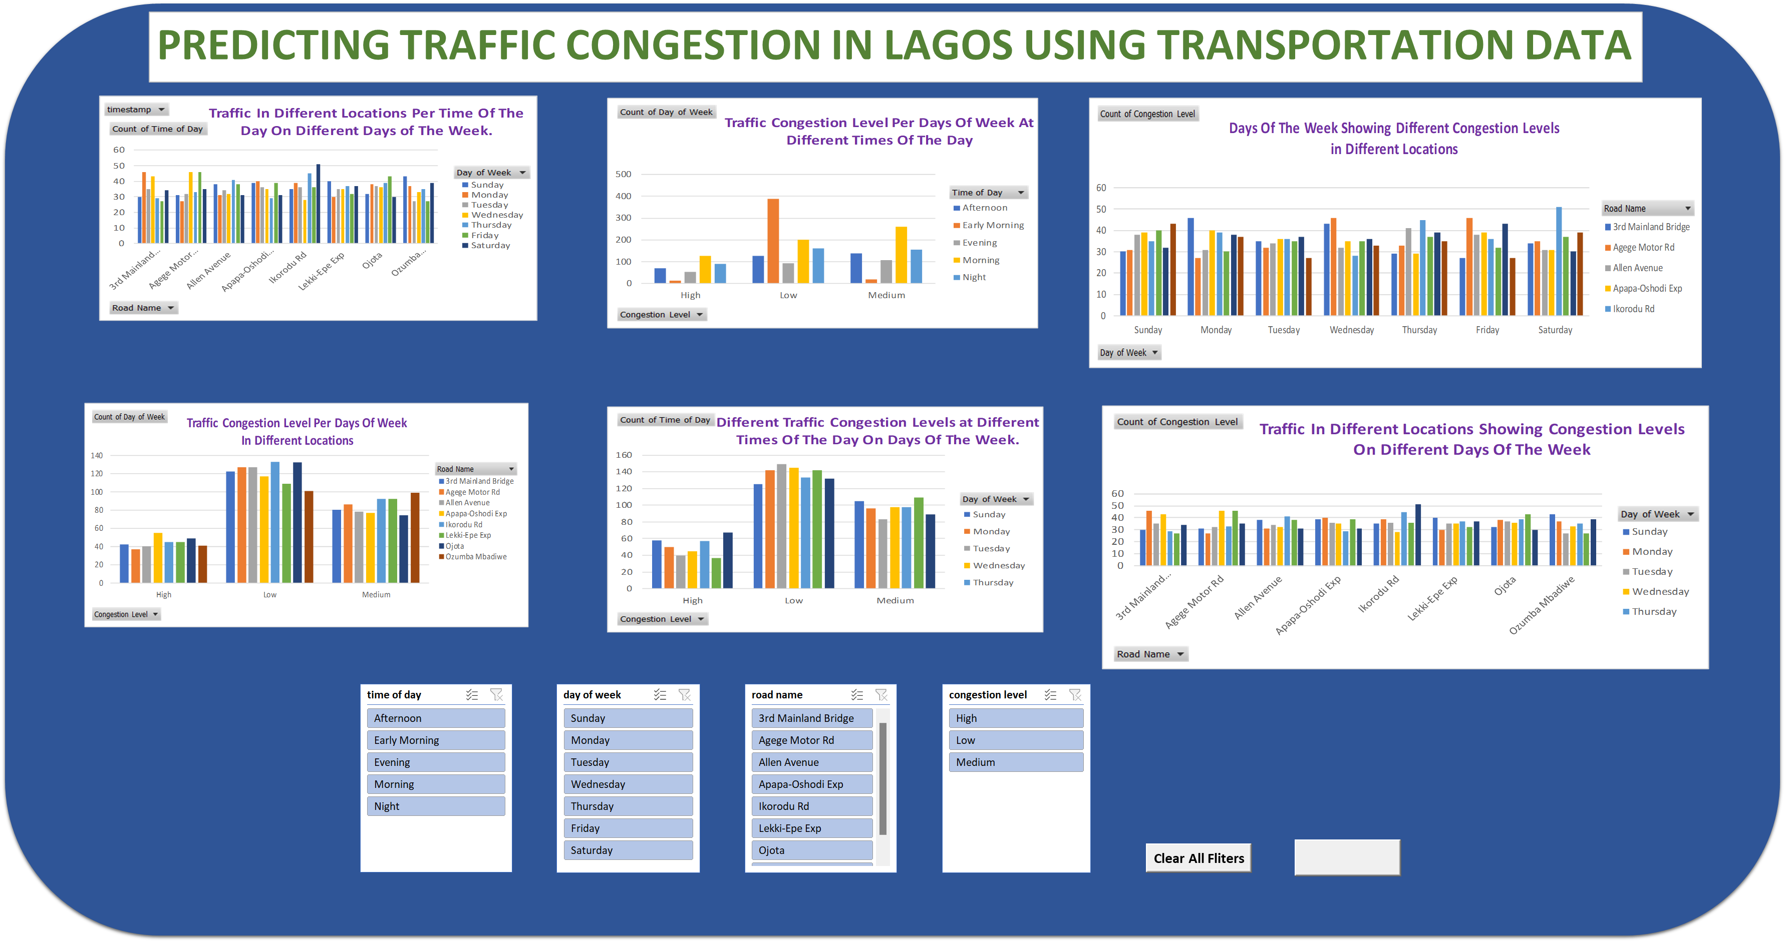

Slide 5
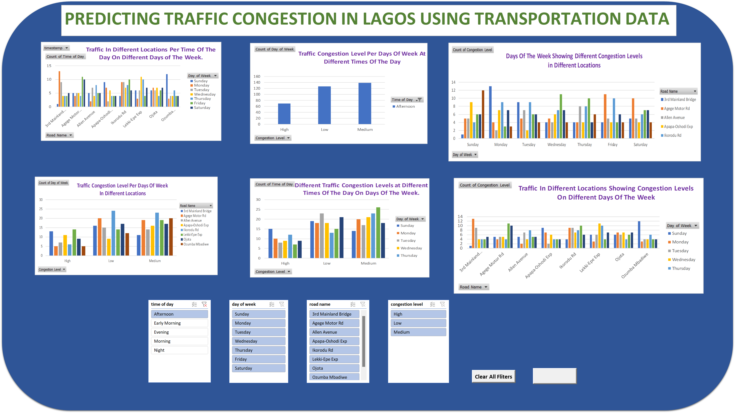

Slide 6
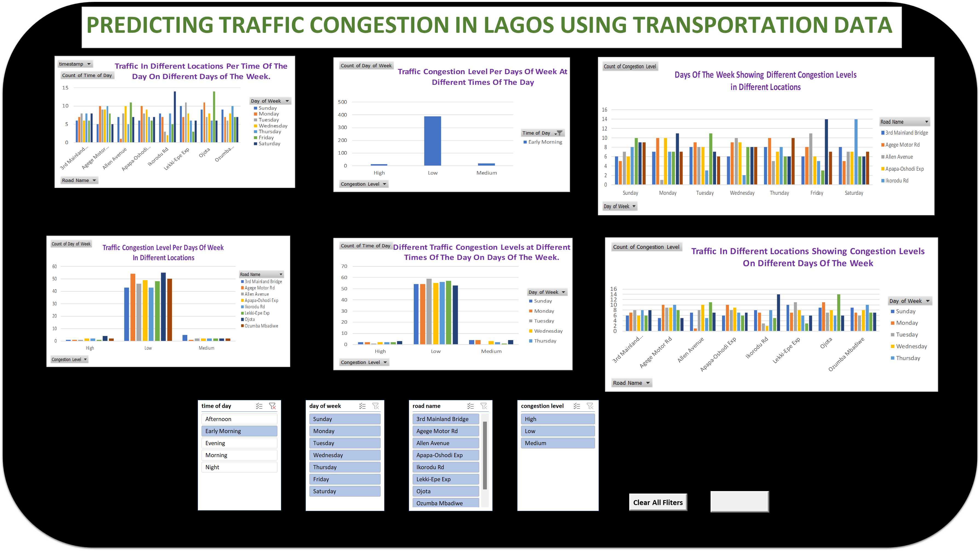

Slide 7
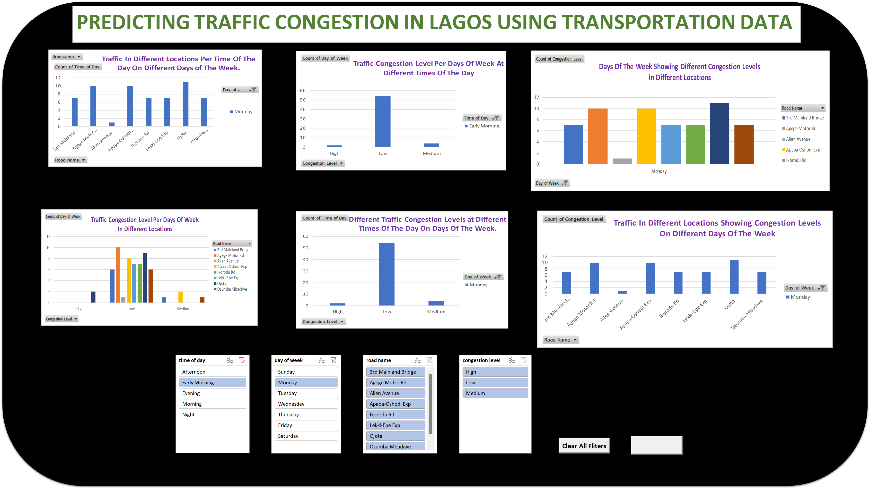

Slide 8
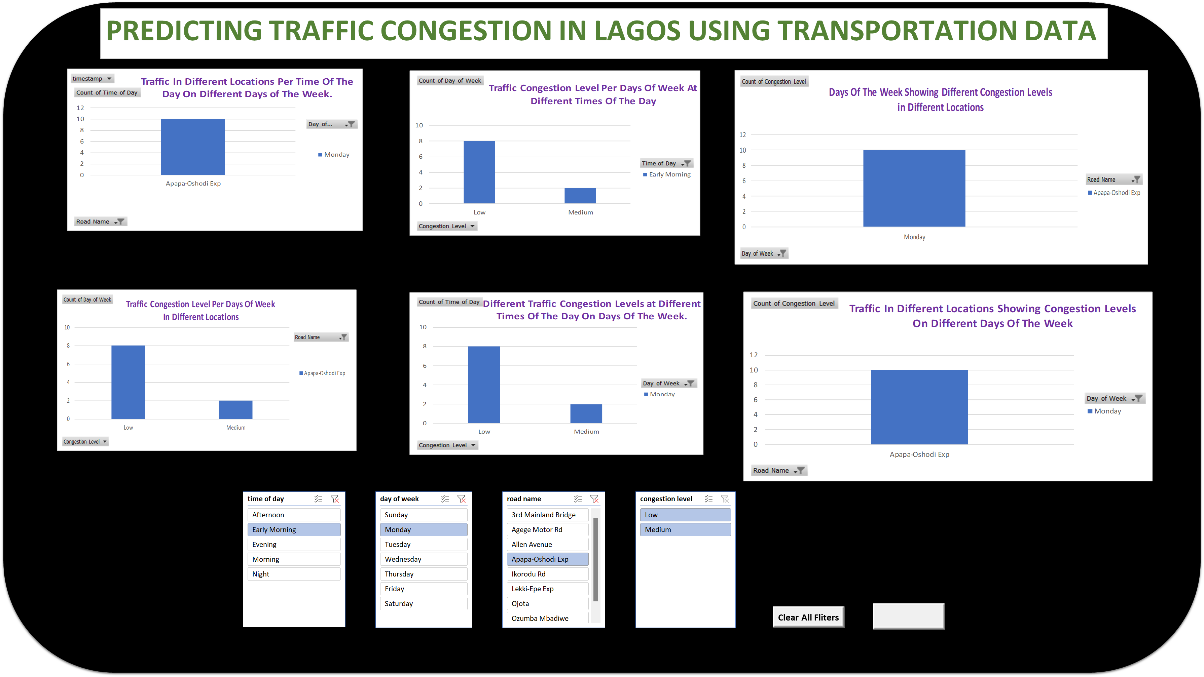

Slide 9
